Slide 1
Annual General Meeting – 2022/23
Montroyal PAC
Chair update
https://www.montroyalpac.com

Slide 2
OVERVIEW
Context (recent past)
Accomplishments 2022/23
Needs for 2023/24
https://www.montroyalpac.com

Slide 3
Context (recent past)
Pandemic
Fewer events
Momentum difficult
https://www.montroyalpac.com

Slide 4
Accomplishments 2022/23
Events!
Meaningful spends!
Momentum!
Montroyal PAC
https://www.montroyalpac.com

Slide 5
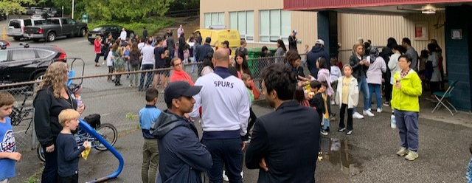
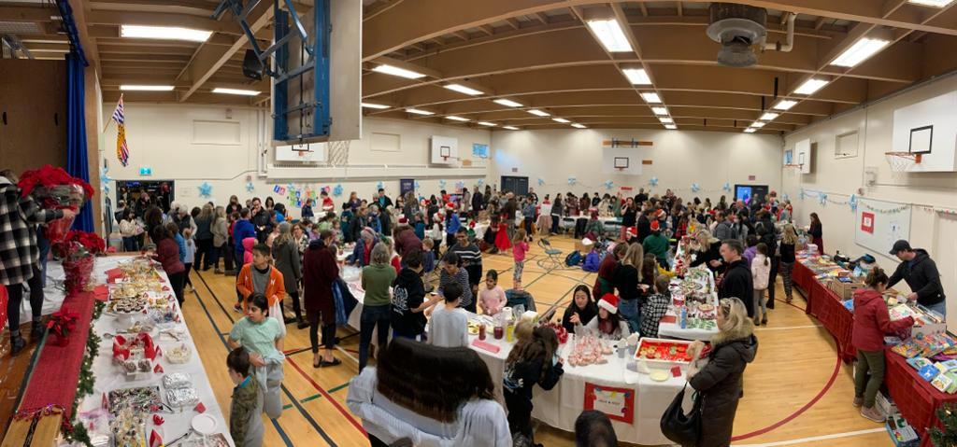
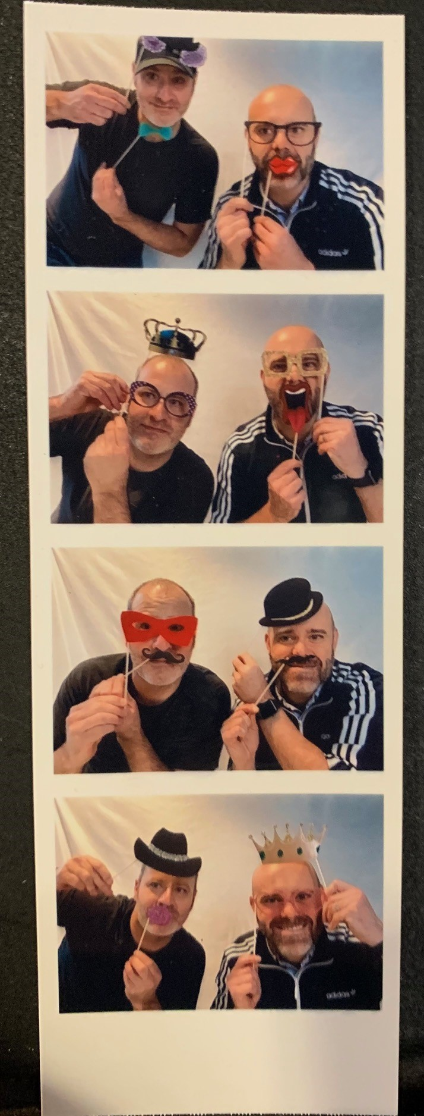
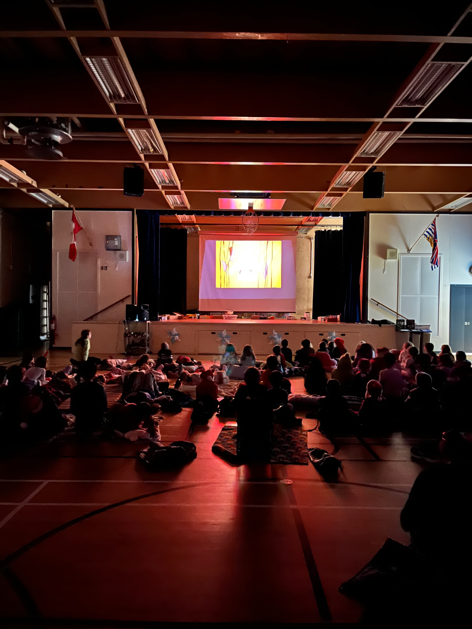
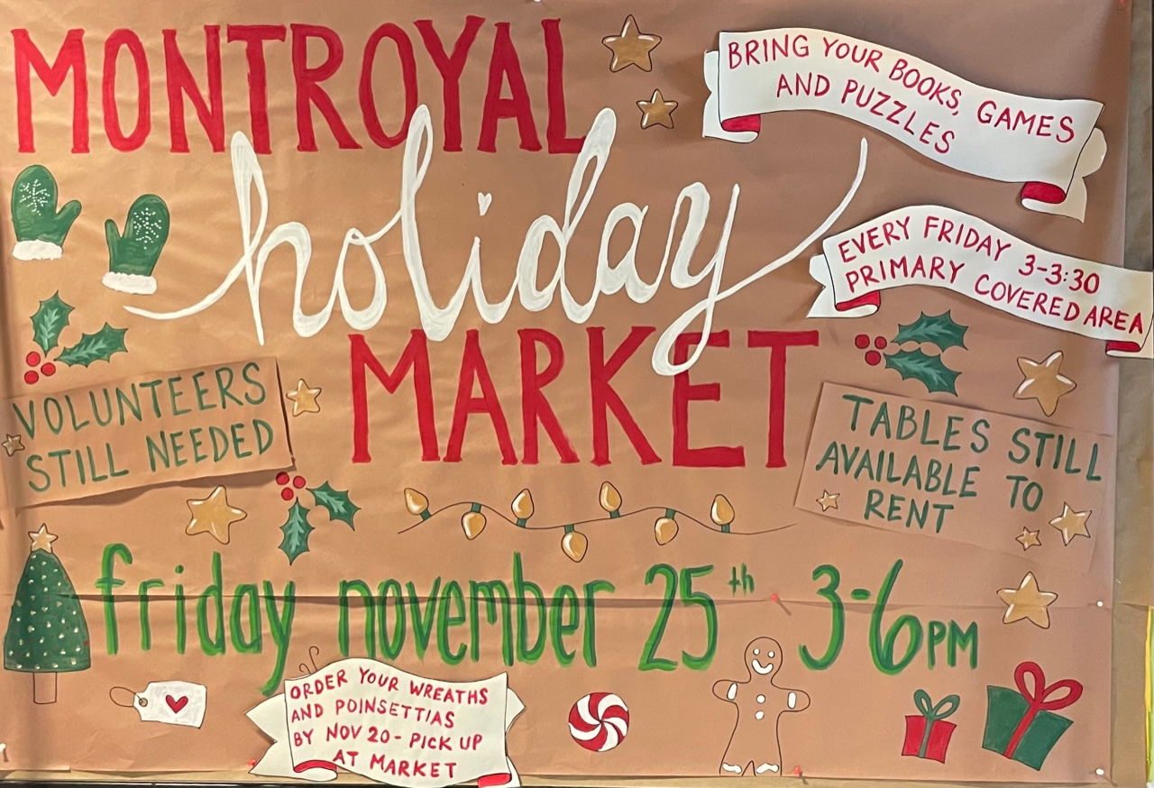
EVENTS!
https://www.montroyalpac.com

Slide 6
EVENTS!
June 1st
Family Dance →
(Also basket raffle @Dance)
June 27th
End of school party
https://www.montroyalpac.com

Slide 7
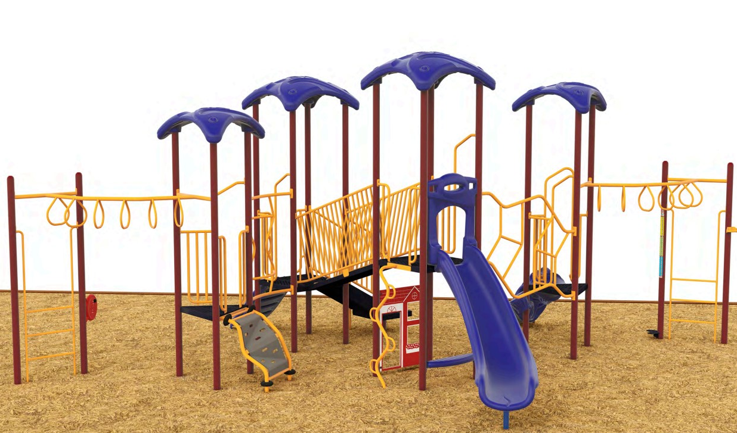
Meaningful spends!
Replacement play structure (Lowers)
Outdoor learning space
Additional support (for
tech, athletics, performing
arts, and invited
presentations)
Indigenous Art
Needs for 2023/24…
https://www.montroyalpac.com

Slide 8
YOU!
We can build a culture of parental involvement.
Effort
Ideas
Enthusiasm
“We may be small, but we are mighty.”
https://www.montroyalpac.com

Slide 9
Needs for 2023/24
Specific roles:
Treasurer (required or PAC dissolved)
Secretary
Volunteer coordinator
Programs coordinator
Other volunteering:
Hot lunches, events, etc.
https://www.montroyalpac.com

Slide 10
Needs for 2023/24
Share a role between multiple people
Share your ideas for PAC and we’ll support you in making them happen
Read the regular PAC emails (they’re great!)
Planning is already underway for events in September and the Fall
chair@montroyalpac.com,
info@montroyalpac.com
(Welcome back event on Sep 14)
https://www.montroyalpac.com

